Slide 1

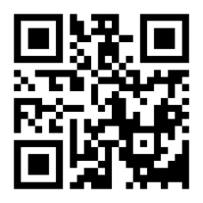
www.crossroads5k.com
SCAN THE QR CODE TO REGISTER

